Slide 1
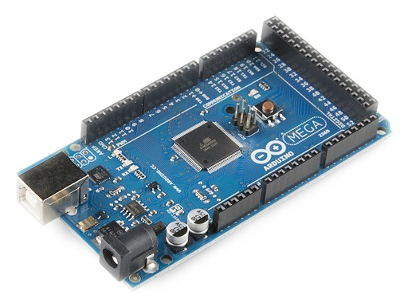
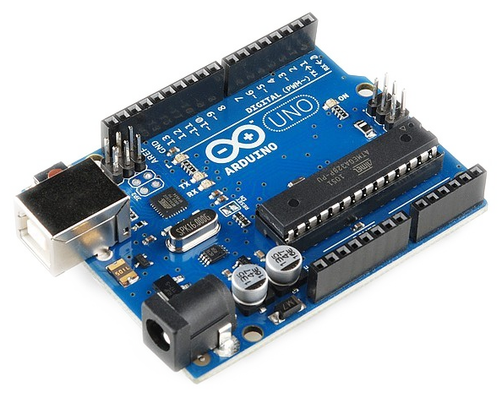
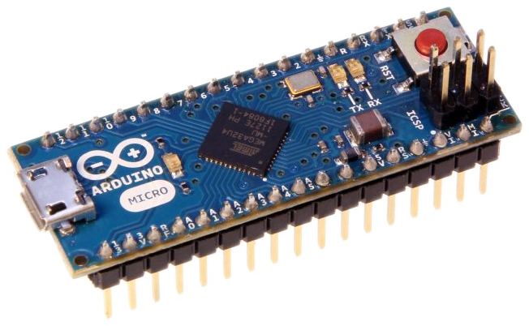
Intro to Microcontrollers with Arduino
Julien de la Bruère-Terreault
©2017, Julien de la Bruère-Terreault drgfreeman@tuta.io This work is licensed under a Creative Commons Attribution-ShareAlike 4.0 International License.

Slide 2
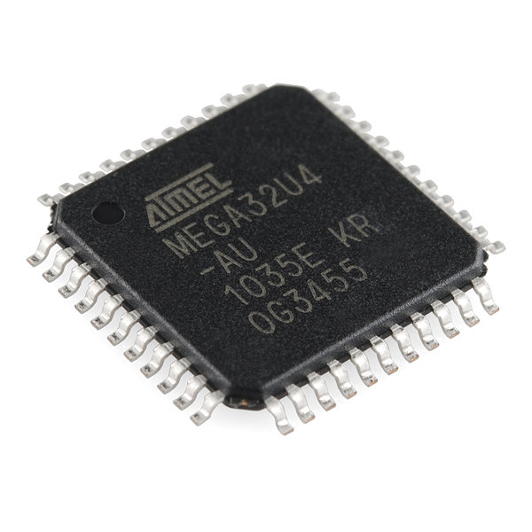
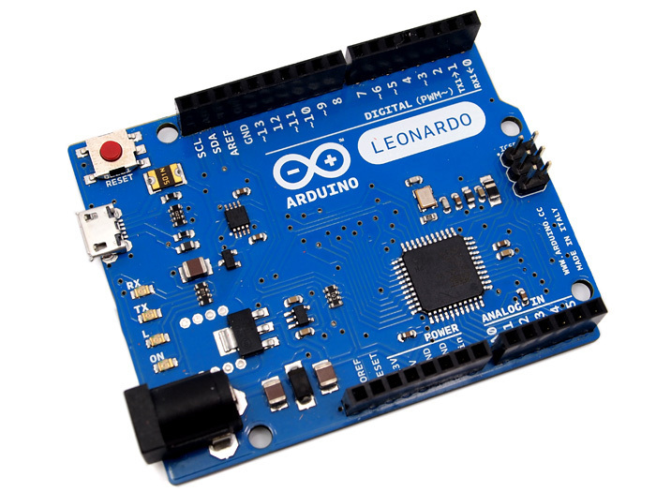
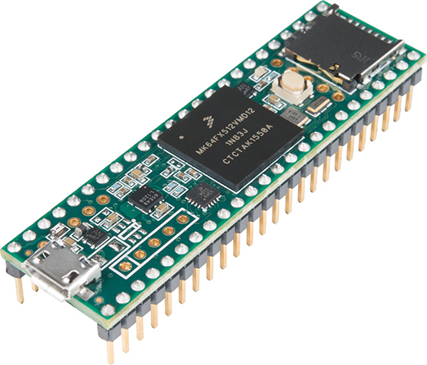
Microcontrollers and Development Boards
Microcontrollers are integrated circuits (IC) that includes a central processing unit (CPU), memory and input / output peripherals (GPIO) on a single chip. Most microcontrollers also include Analog-Digital Converters (ADCs), timers and interrupts.
Development boards are printed circuit boards combining, in a practical format, a microcontroller with features such as :
GPIO pins or connectors
Voltage regulator
Built-in LEDs
USB interface
Various board specific features
ATmega 32U4
microcontroller
ARM Cortex M4
microcontroller
Teensy 3.5 development board
Arduino Leonardo development board
©2017, Julien de la Bruère-Terreault drgfreeman@tuta.io This work is licensed under a Creative Commons Attribution-ShareAlike 4.0 International License.

Slide 3
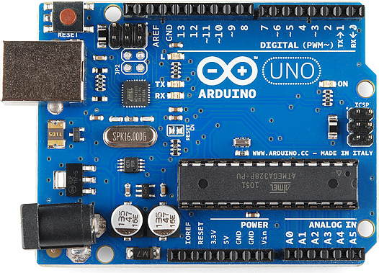
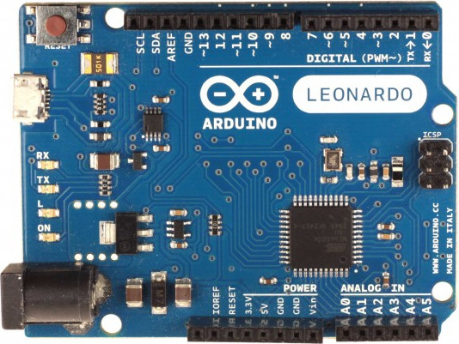
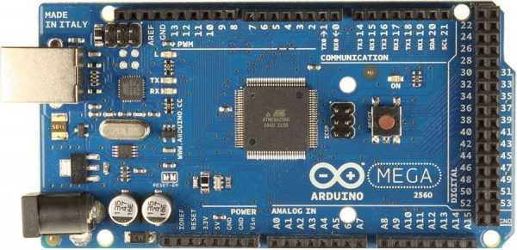
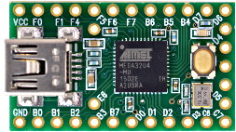
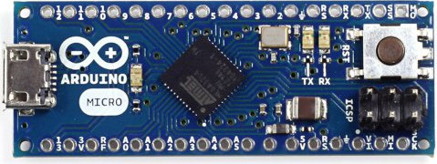
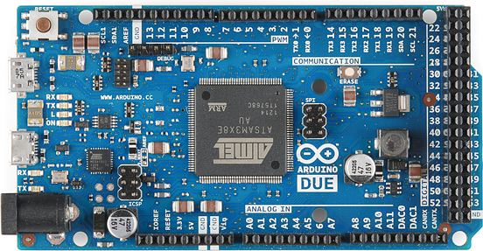
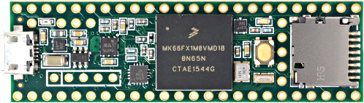
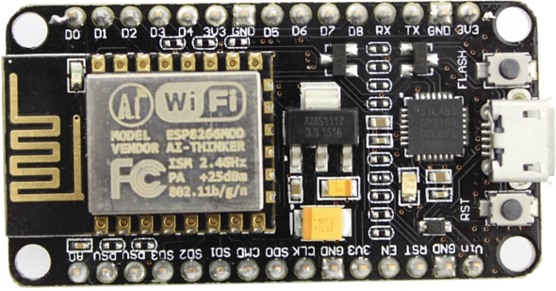
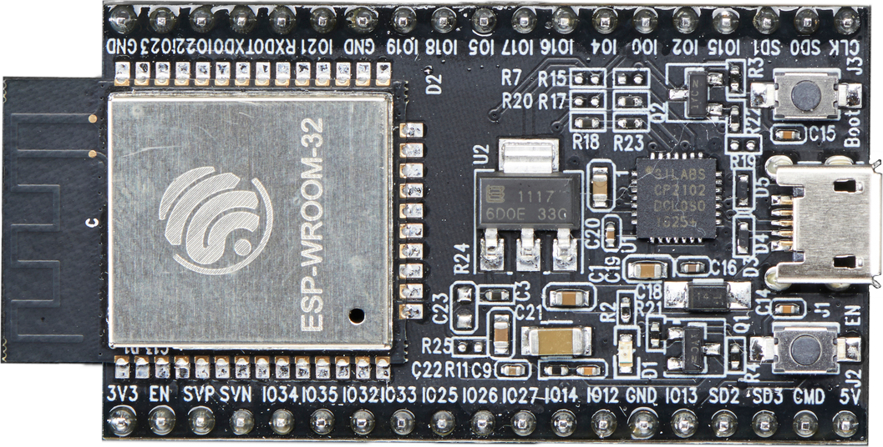
Popular development boards
8 bits - 5V logic level | Arduino Uno R3 ATmega 328P | Arduino Mega ATmega 2560 | Arduino Leonardo/Micro ATmega 32U4 | Teensy 2.0 ATmega 32U4
32 bits - 3.3V logic level | Arduino Due ARM Cortex M3 | Teensy 3.x ARM Cortex M4 | NodeMCU ESP2866 Wi-Fi chip / Microcontroller | Adafruit ESP32 ESP32 Wi-Fi / Bluetooth / Microcontroller
©2017, Julien de la Bruère-Terreault drgfreeman@tuta.io This work is licensed under a Creative Commons Attribution-ShareAlike 4.0 International License.

Slide 4
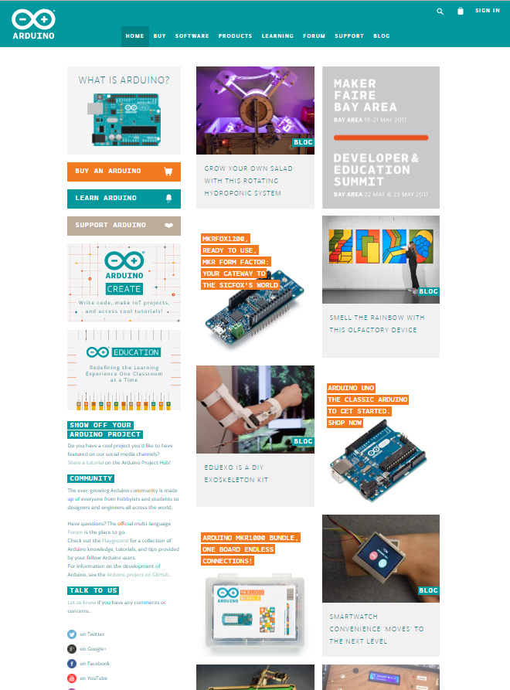
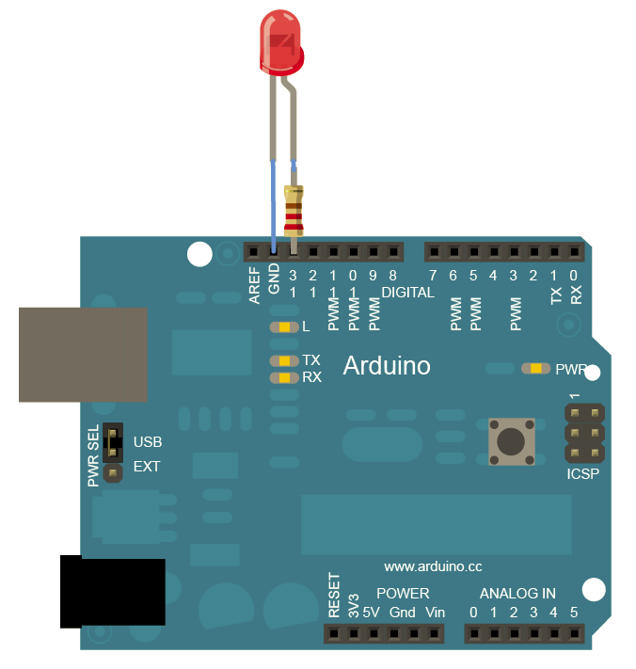
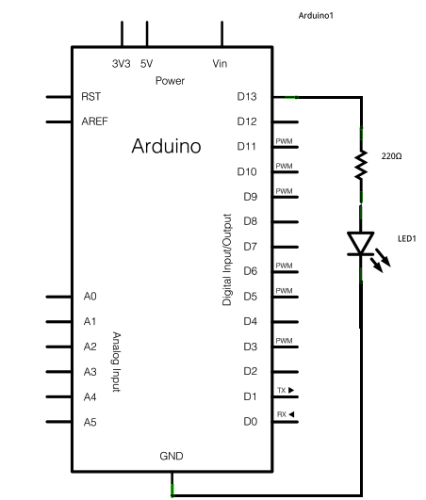
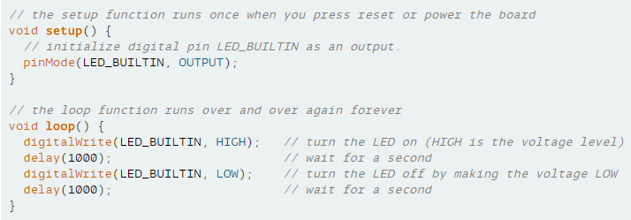
Getting Started with Arduino
Arduino is an open source, computer hardware and software company, project, and user community that designs and manufactures microcontroller kits for building digital devices and interactive objects that can sense and control objects in the physical world. The project's products are distributed as open-source hardware and software. (Wikipedia)
Arduino resources on arduino.cc :
Getting started guide
Arduino introduction
Arduino tutorials
How it works: Foundations
Language reference
Arduino IDE
©2017, Julien de la Bruère-Terreault drgfreeman@tuta.io This work is licensed under a Creative Commons Attribution-ShareAlike 4.0 International License.

Slide 5
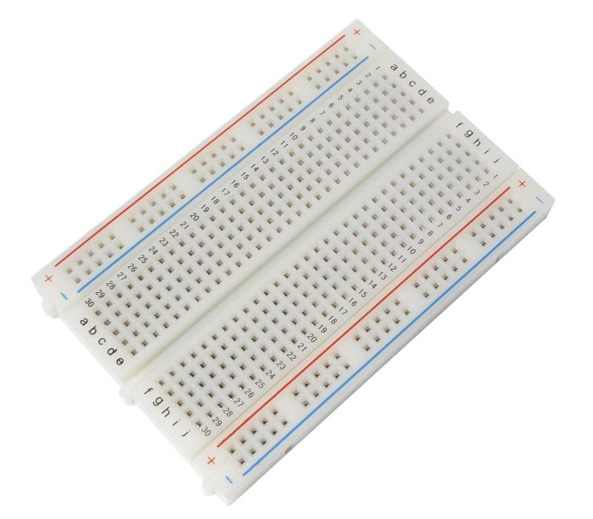
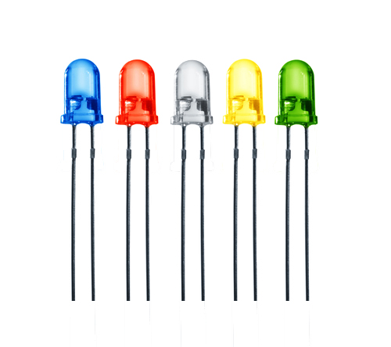
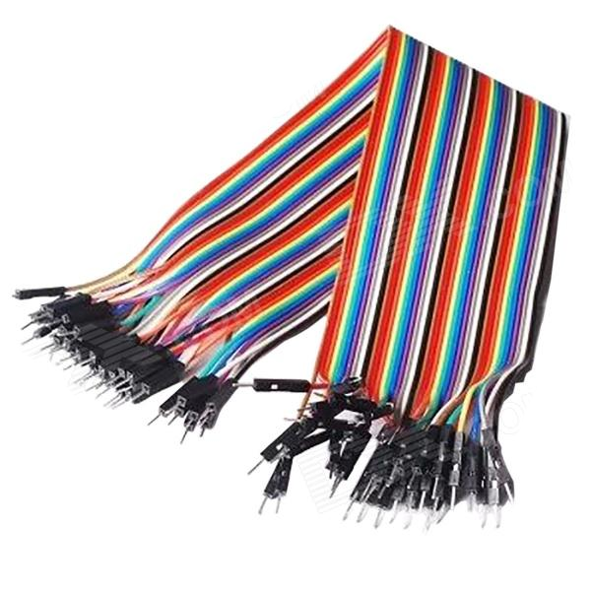
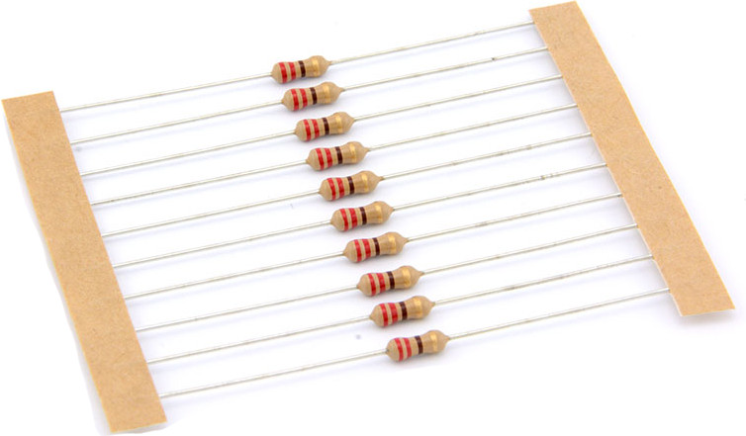
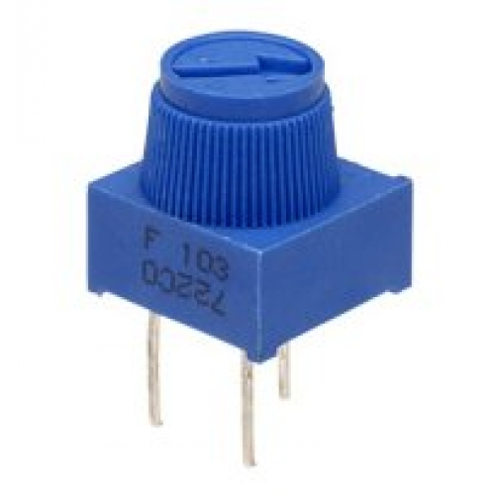
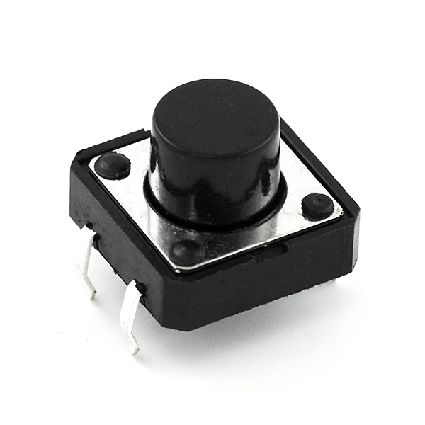
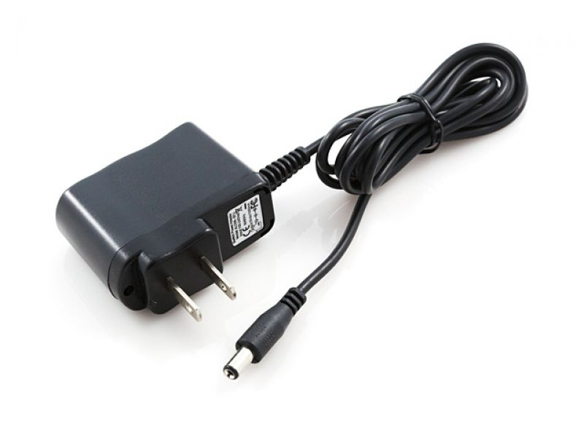
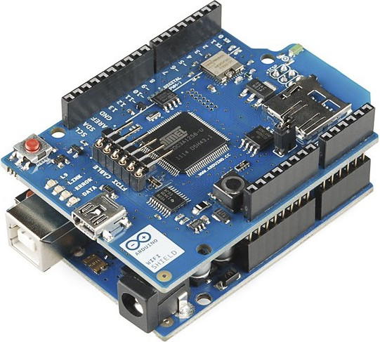
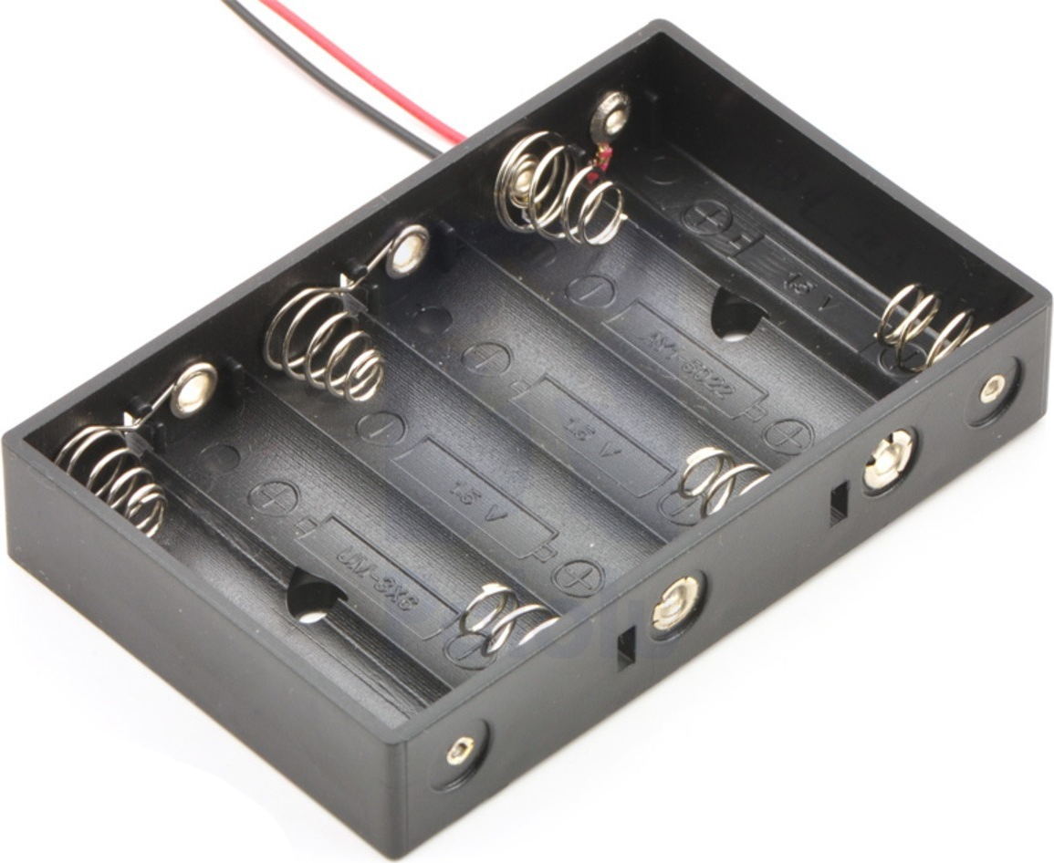
Recommended material
Arduino board:
UNO: Most popular, versatile
Leonardo: More I/Os, more interrupts than Uno
Micro: Same as Leonardo in a smaller format.
Uno and Leonardo share the same form factor and are compatible with a variety of third party shields.
Micro is cheap and compact, perfect for permanent setups. Requires welding of header pins or wires directly to the board.
Leonardo and Micro can emulate a keyboard or mouse when connected to a computer.
Uno, Leonardo and Micro all have a 5V logic level.
Other material:
USB cable
Prototyping breadboard
Jumper wires
LEDs
Resistors (220 ohm, 10K ohm)
Potentiometers (variable resistor, 10K ohm)
Pushbuttons
Power supply or batteries
©2017, Julien de la Bruère-Terreault drgfreeman@tuta.io This work is licensed under a Creative Commons Attribution-ShareAlike 4.0 International License.

Slide 6
Power Considerations
Powering the Arduino (5V boards):
USB power: provides enough power for the Arduino and low current peripherals (e.g. single LEDs).
Vin pin / barrel plug : 7-12V input powering the on-board voltage regulator.
Power source selection is automatic
Powering peripherals:
5V pin: Output of on-board voltage regulator, ~250 mA max.
3.3V pin: Regulated output, 50 mA max.
GPIO pins: 20 mA max per pin.
An external power source is recommended for peripherals drawing more than 250 mA total. Motors and servos definitively need to be powered by an external power source (power supply or batteries).
Adruino Uno / Leonardo
In Out
Adruino Micro
©2017, Julien de la Bruère-Terreault drgfreeman@tuta.io This work is licensed under a Creative Commons Attribution-ShareAlike 4.0 International License.

Slide 7
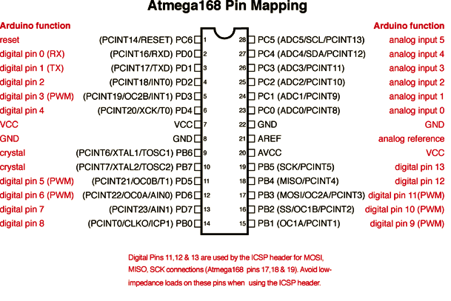
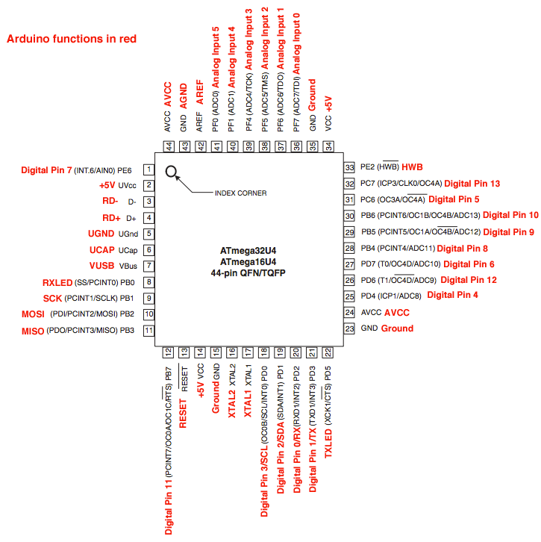
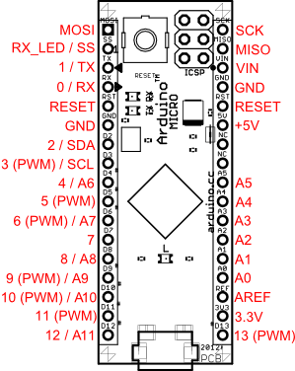
Pin MaPPING Diagrams (PINOUT)
The pinout diagrams provide information about the different functions of each pin of the microcontroller.
Analog-Digital Converter (ADC) “Analog Pins”
Pulse Width Modulation (PWM) enabled pins
Serial communications (TX/RX, SDA/SCL, SPI) pins
Interrupts and Pin Change Interrupts (INT/PCINT)
ATmega port and bit number for direct access
The diagrams are available for each board on the Arduino products page.
©2017, Julien de la Bruère-Terreault drgfreeman@tuta.io This work is licensed under a Creative Commons Attribution-ShareAlike 4.0 International License.

Slide 8
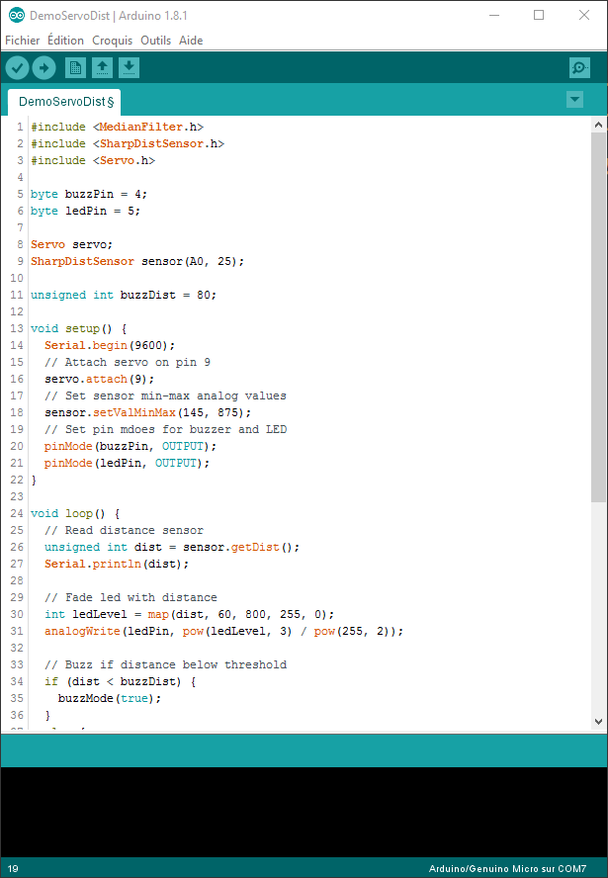
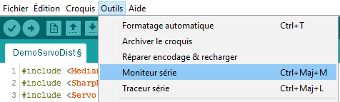

Programming the Arduino
Arduino programs are developed on a personal computer (Windows, Mac, Linux) using the Arduino IDE (Interactive Development Environment).
When ready, the program is compiled and then uploaded to the Arduino flash memory via the USB connection or a through some dedicated pins (ICSP).
The Arduino loads and runs its program as soon as it is powered.
The Arduino can run without connection to the computer but can communicate with the computer over a serial connection through the USB cable (access via the IDE’s Serial monitor).
Arduino IDE
Compile and Upload buttons
Serial monitor in the Tools menu
©2017, Julien de la Bruère-Terreault drgfreeman@tuta.io This work is licensed under a Creative Commons Attribution-ShareAlike 4.0 International License.

Slide 9
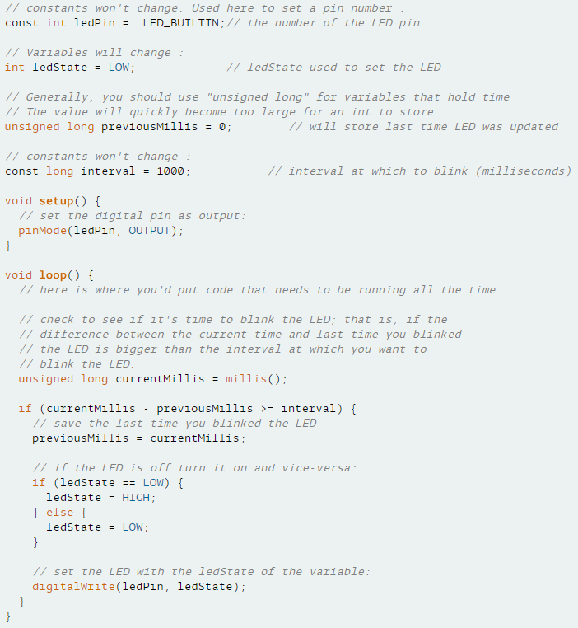
A Typical Arduino program (SKETCH)
BlinkWithoutDelay.ino example sketch
The main program is stored in an Arduino “sketch” (.ino file)
The sketch can optionally include:
Declaration of global variables
Functions defined in the sketch file
Functions / classes defined in a separate file within the sketch folder
Functions / classes defined in external libraries
The sketch minimally includes two functions:
The setup() function runs only once
The loop() function runs continuously
©2017, Julien de la Bruère-Terreault drgfreeman@tuta.io This work is licensed under a Creative Commons Attribution-ShareAlike 4.0 International License.

Slide 10
Where to Buy
Buyapi.ca (CAN) https://www.buyapi.ca/
RobotShop (CAN) http://www.robotshop.com/ca/en/
Adafruit (US) https://www.adafruit.com/
SparkFun (US) https://www.sparkfun.com/
Amazon.ca
ebay.ca
©2017, Julien de la Bruère-Terreault drgfreeman@tuta.io This work is licensed under a Creative Commons Attribution-ShareAlike 4.0 International License.

